Slide 1



Project Title: Automating Accounts Payable Processes for Royal Gas Using Oracle ERP

Slide 2
Oracle ERP system digital accounting
NXT37_ONL2_ERP4_S1

Slide 3
Inventory
setup
Closing period & ending report
Defining suppliers
Making & paying invoice
Payables setup
Withholding tax setup
Payment setup
Bank
setup

Slide 4

1- Inventory Setup
Before setting up the Payables module, it's essential to have at least one Inventory setup completed. This step ensures the Payables module can function correctly and be linked with other modules in the system.

Slide 5
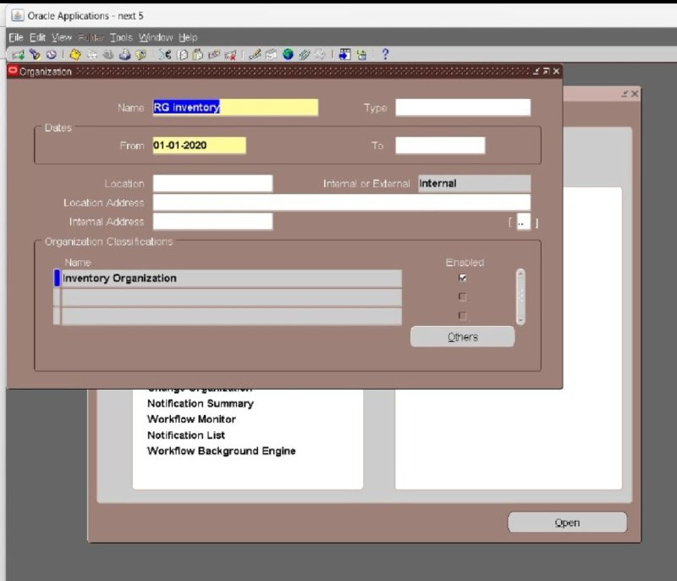
In this stage, we created an Inventory Organization, which includes :
The name of the organization
The creation date
Its active status
This organization will be linked to our payables transactions and item management processes later on

Slide 6
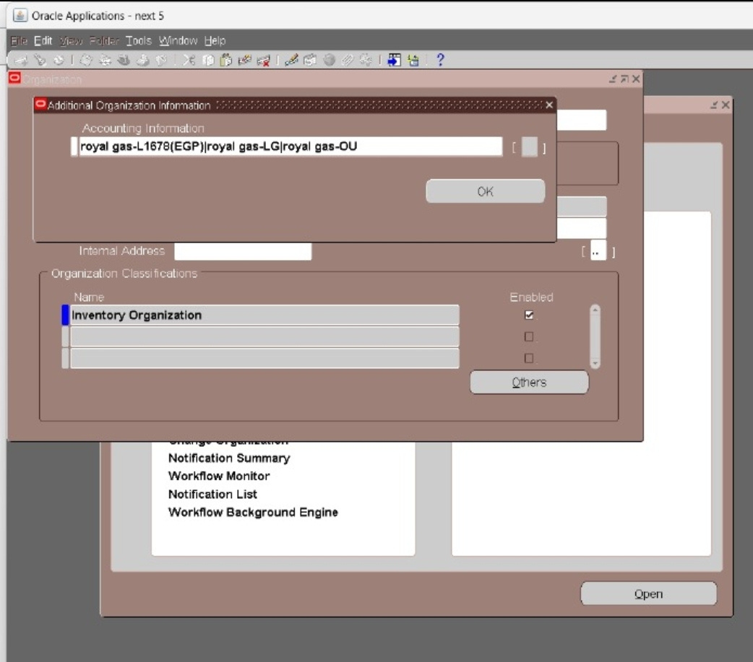
Accounting Information
After creating the Inventory Organization,
the next step is to link it with
the financial and legal structure of the business.
This includes:
Ledger: Royal Gas L
Legal Entity: Royal Gas LG
Operating Unit: Royal Gas OU
These connections are crucial
to ensure proper data flow and integration
between the Inventory and Payables modules.
The screenshot below shows the successful
linkage of our Inventory Organization with the above entities

Slide 7
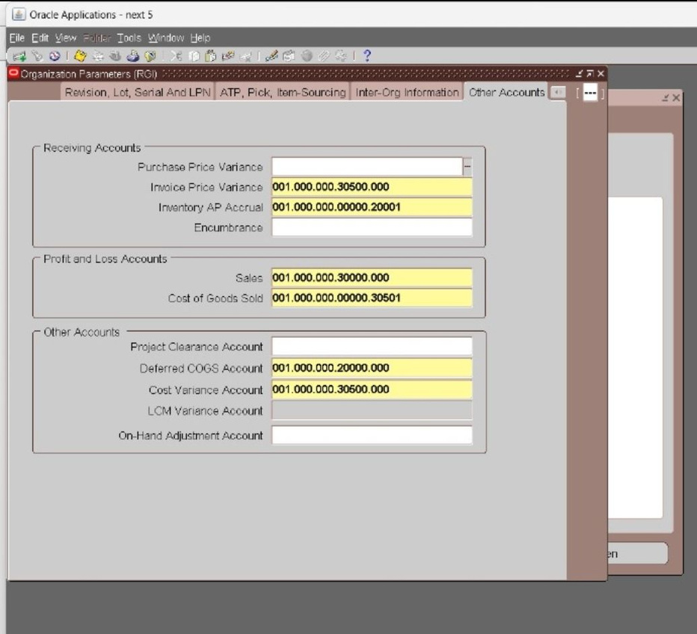
Inventory information - key financial setting
In this step, we defined the key financial and cost-related settings for our Inventory Organization. These configurations ensure accurate accounting during inventory and payables transactions.
: Key Account Settings
Invoice Price Variance: We assigned the Purchase Expense Account code.
Inventory AP Accrual: We assigned the AP .Accrual Account code
Sales: Linked to the Sales Revenue account.
COGS: Linked to the Expense Account for cost of goods sold.

Slide 8
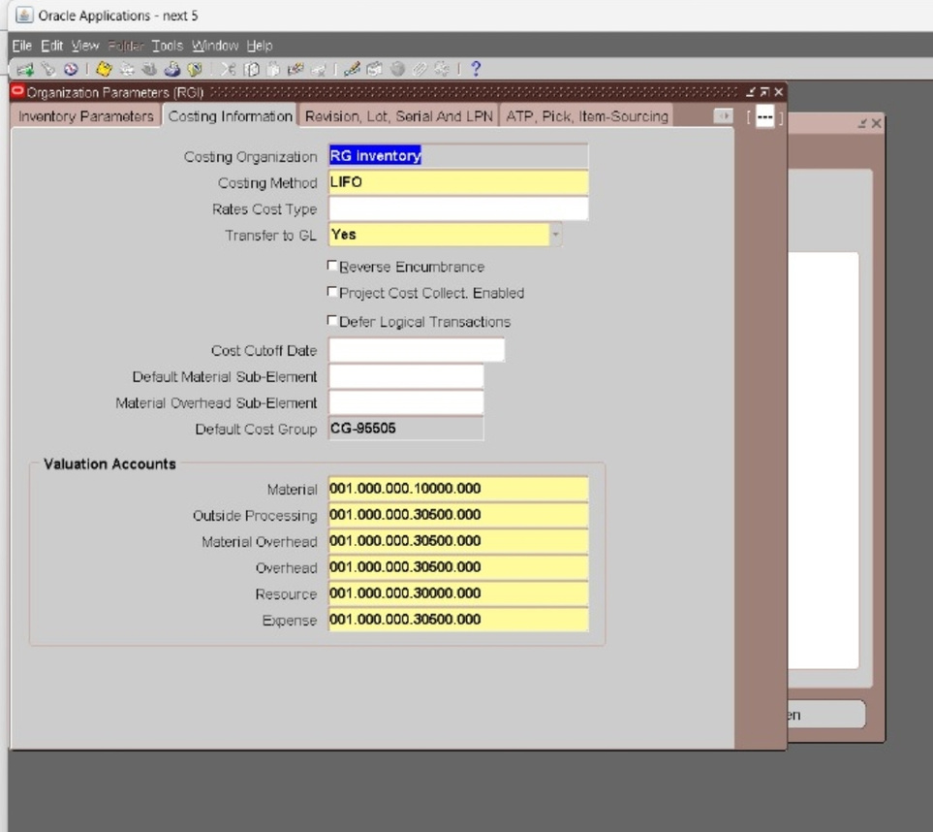
Costing Method:
We selected LIFO (Last In, First Out) as the costing method.
Additional Accounts Configured:
Material Account - Outside Processing Account
Material Overhead Account - Overhead Account
Resource Account - Expense Account
These accounts play a critical role in tracking inventory movement, processing transactions, and generating accurate financial reports.

Slide 9
2- defining suppliers
To define suppliers that the organization deals with for purchasing goods or services and enable invoice and payment processing through Oracle Payables

Slide 10
1. Created Supplier Records (Added three suppliers)
Supplier A
Westinghouse
Supplier B
BEBA
Supplier C
Galasseco

Slide 11
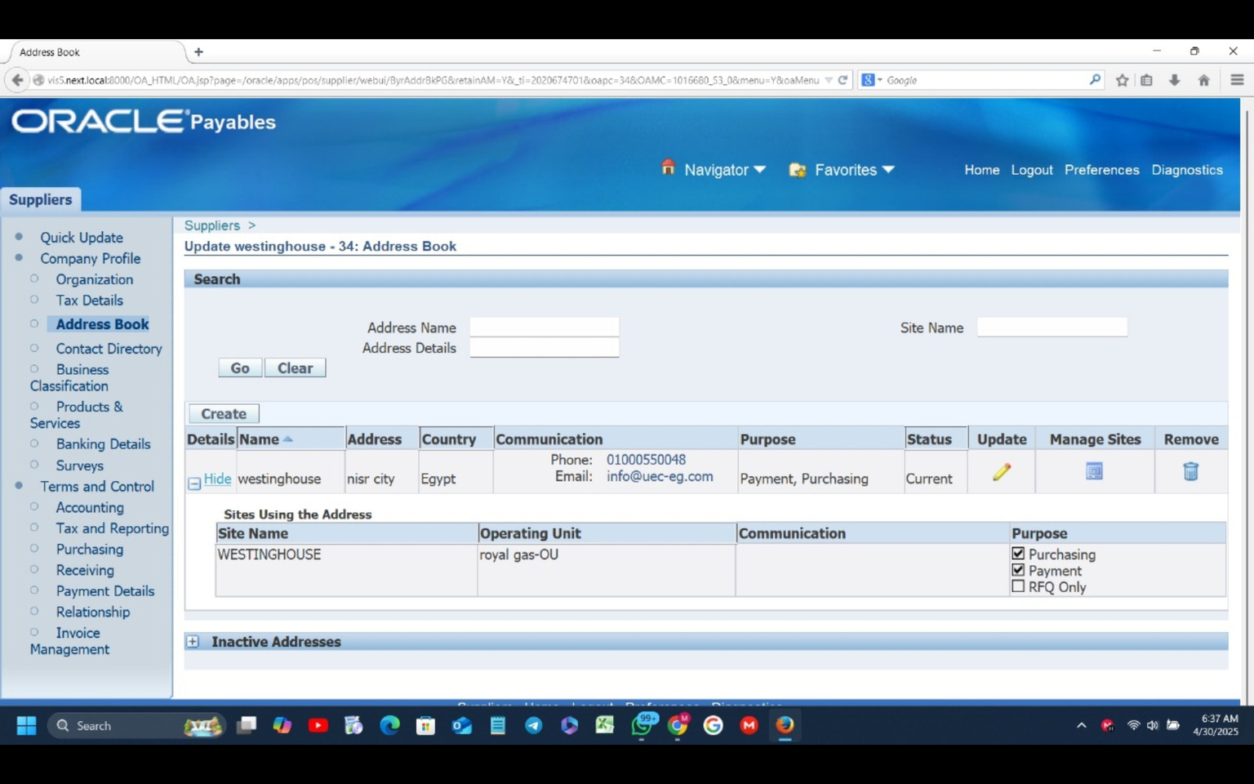
2. Entered Supplier Information
Supplier name and type (Company / Individual) -
Payment method (Check / Electronic) -
Communication details (phone, email, address) -
3. Added Sites for Each Supplier
- Site types: Purchasing, Payment
- Payment terms (e.g., Net 30)
- Currency
4. Assigned Bank Accounts
- Linked supplier sites to previously created bank accounts

Slide 12
Payables
System
Setup
Payables
Setup
Payables
Options
Financial
Options

Slide 13

Financial
Options

Slide 14
In the Financial Options setup, we begin by configuring key accounting accounts that are used for handling liabilities, prepayments, discounts, and variances. These accounts help ensure accurate tracking and reporting of financial transactions in the Payables module

Slide 15
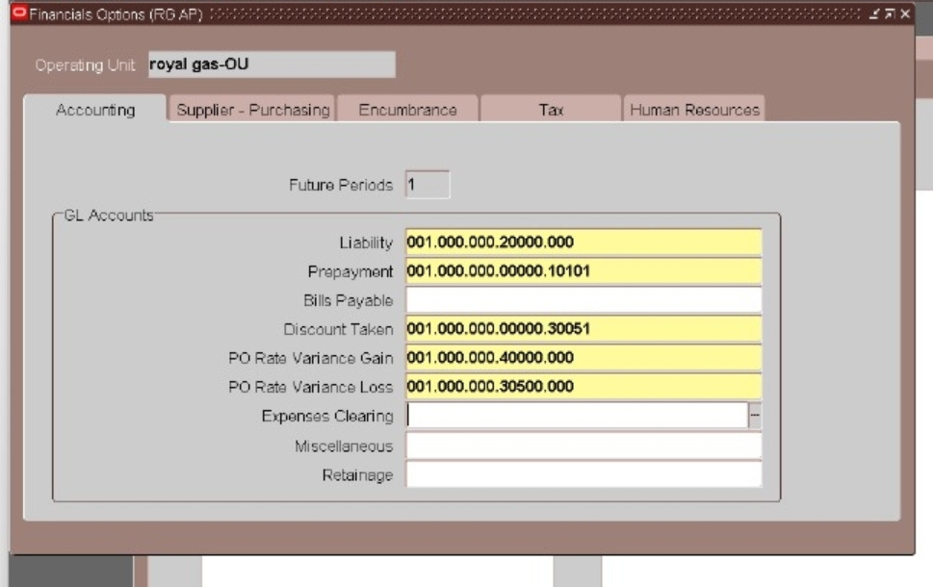
Key Accounting Accounts Configured:
Liability Account: We assigned the relevant liability account code.
Prepaid Account: Assigned the appropriate prepaid account code.
Discount Taken Account: Linked to the discount account for recording discounts received.
PO Rate Variance Gain Account: We assigned the account to track any gains from purchase order rate variances.
PO Rate Variance Loss Account: Assigned the expense account to record any losses related to purchase order rate variances.
These accounts ensure proper management of financial transactions related to payables, including handling prepayments, discounts, and rate variances.

Slide 16
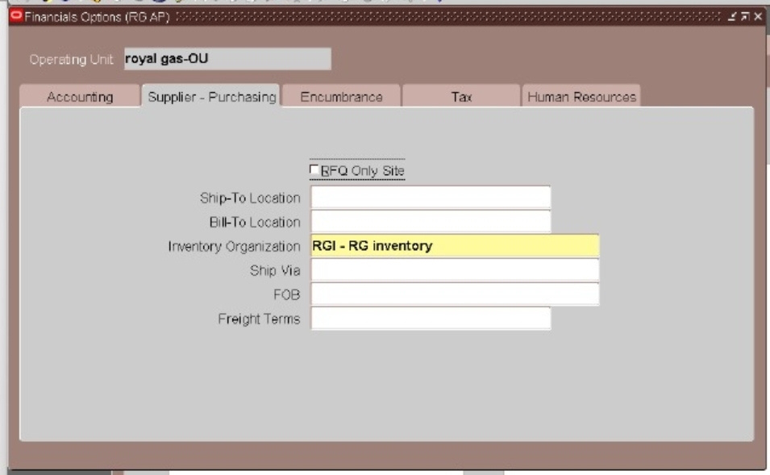
In the Supplier-Purchasing section of the Financial Options, we focused on linking the previously created Inventory Organization to the Payables module.
This ensures that the inventory setup is properly integrated with supplier and purchasing processes.
Key action:
We linked the Inventory Organization we created earlier to the supplier and purchasing settings. With this step, we ensure smooth integration between inventory management and the Payables system, allowing for accurate tracking and accounting of purchases.

Slide 17

Payables
System
Setup

Slide 18
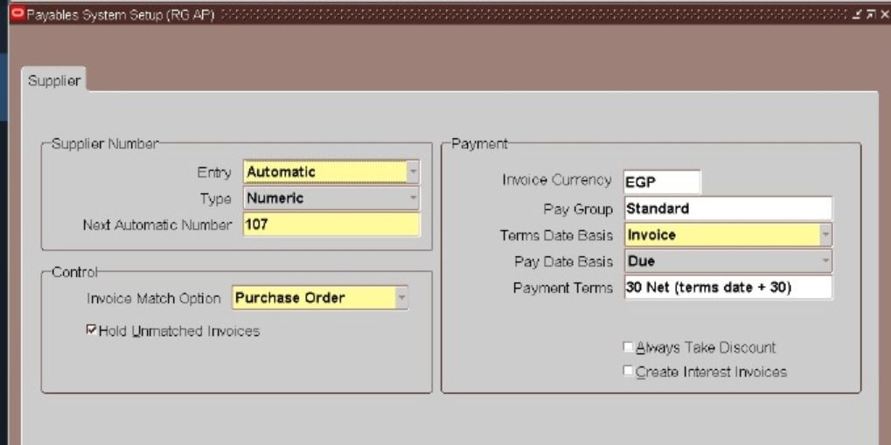
Supplier Numbering: We defined how supplier numbers
will be generated either automatically or manually, and set the next supplier number for future use.
Invoice Match Option: We selected the invoice matching method:
PO-based Matching: This is a 2-way match, where invoices are matched with Purchase Orders (PO).

Slide 19
Receipt-based Matching: This is a 3-way match, where invoices are matched with both Purchase Orders and Receipts.
Terms Date Basis: We configured the Terms Date Basis to be based on the Invoice Date, ensuring that payment terms are calculated correctly from the invoice date.
These settings are essential for ensuring that invoices are processed correctly and matched with the appropriate documents to avoid errors and crepancies.

Slide 20

Payables
Options

Slide 21
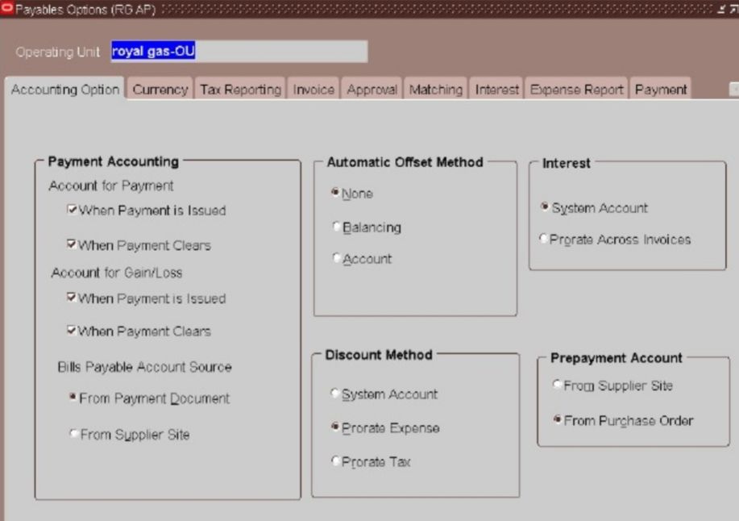
Accounting Options
In the Payables Options setup, we configure critical accounting and currency settings that define how payments, gains, losses, and rounding are handled in the Payables module.
Key Accounting Options:
Accounting for Payment: We configured two key stages for payment accounting:
When Payment is Issued: The payment is recorded as soon as it's issued.
When Payment Clears: The payment is updated in the system once it clears the bank.

Slide 22
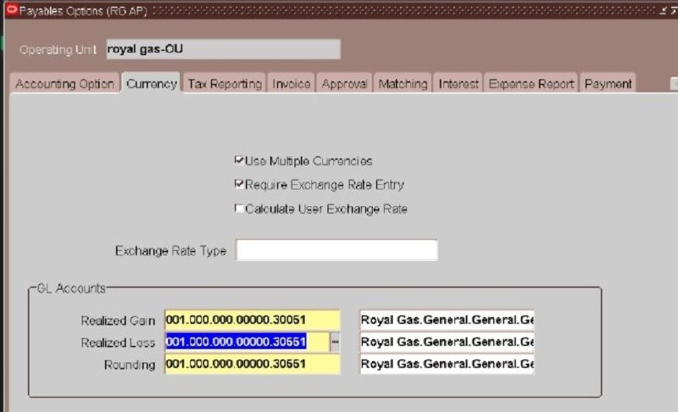
Currency setting
We enabled the ability to make payments in multiple currencies, ensuring flexibility for international transactions.
Realized Gains and Losses:
Realized Gain: We assigned the Other Revenue account to track any gains from currency fluctuations.
Realized Loss: We assigned the Other Expense account to track any losses from currency fluctuations.
Rounding Account:
We configured the Other Expense Account to handle any rounding differences during payment processing.
These settings are crucial for handling currency-related transactions and ensuring that payments and associated financial entries are accurately recorded.

Slide 23
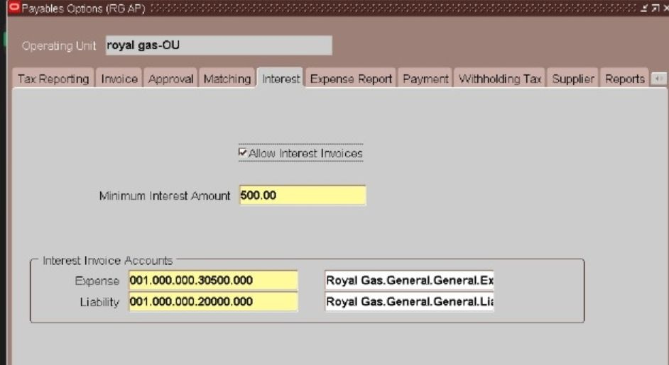
Interest Settings
We also configured additional important sections under Payables Options to control how interest and payments are handled.
Interest Settings:
Minimum Interest Amount: Set to 500, meaning the system will only calculate and apply interest if the amount exceeds this threshold.
Expense Account: Assigned to record interest expenses.
Liability Account: Assigned to record interest liabilities
These settings help manage overdue payment penalties in a structured and automated way.

Slide 24
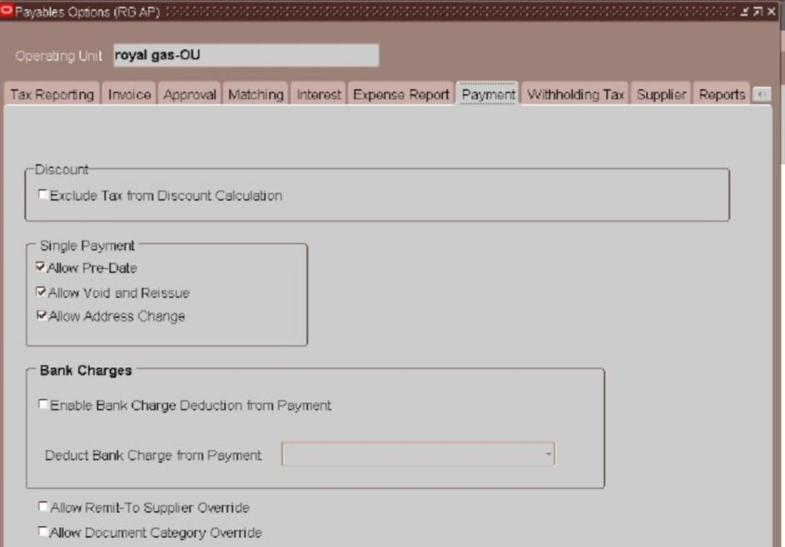
Payments Setting
Payments Settings: Under Single Payment Options, we enabled several key features:
Allow Predate: Allows creating payments with a date earlier than the system date.
Allow Void and Reissue: Enables canceling a payment and issuing a new one in case of errors.
Allow Address Change: Allows editing the supplier's address during the payment process.
These configurations offer flexibility in handling exceptional payment cases while maintaining process.

Slide 25
Create
Format
Templet
Payment
Setup
Payment Process
Profile

Slide 26
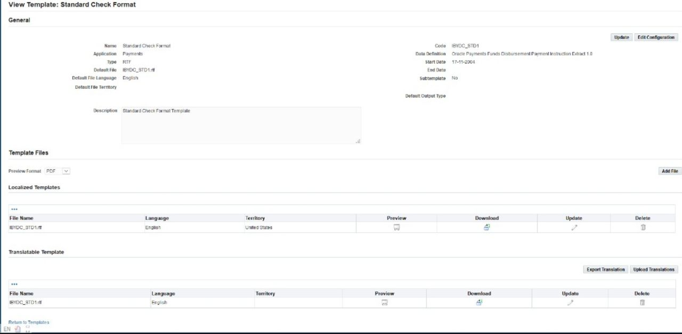
Create format templet
Downloading the Standard Check Format Template Navigate to the Payments Administrator responsibility in Oracle Applications. Go to XML Publisher format Templates . Search for the Standard Check Format Template using its name or template code. Select the desired template and click Download to get the RTF file. Save the RTF file locally for further customization.

Slide 27
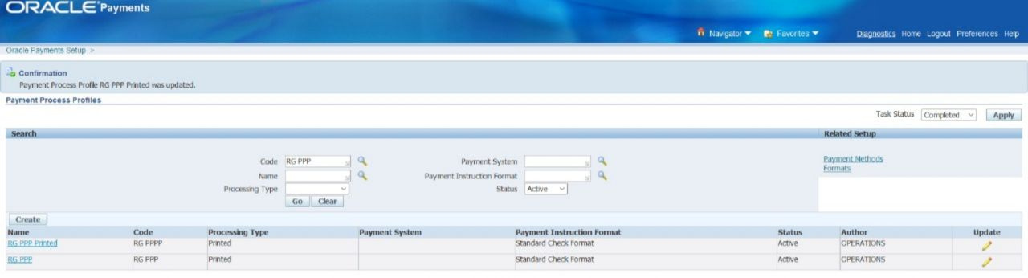
Payment Process Profile Setup
Details of the Configured Profile:
Name: RG PPP
Type: Printed
Usage: Linked to the QNP Check Book
Status: Active
Payment Method: Check
Format: Standard Check Format
Document Category: Payables Payment Documents
Assigned to: Bank Account used for Standard Invoice payments

Slide 28
5- Bank Setup in Oracle Objective:
To configure banking structure for processing supplier payments and managing financial
transactions securely
Payables Key Steps Implemented:

Slide 29
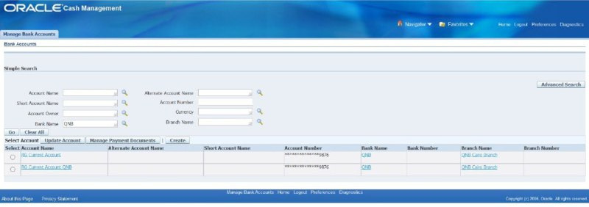
1. Created a New Bank
Name: [ QNP]
Country: [Egypt]
2. Added Bank Branches
Definition name (QNP Cairo Branch)

Slide 30
3. Configured Bank Accounts
Entered account number and defined the currency
Linked the account to the corresponding Legal Entity
Granted access to authorized users via Cash Management responsibility
Defined the account usage (e.g., Payables Payments, Receivables Receipts)

Slide 31
4. Linked Bank Account to Supplier
5. Access Configuration:
Assigned to required responsibilities
Allowed usage through Cash Management

Slide 32
6- Withholding Tax (WHT) Setup
To enable Withholding Tax (WHT) functionality in the Payables module, we followed these key steps:

Slide 33
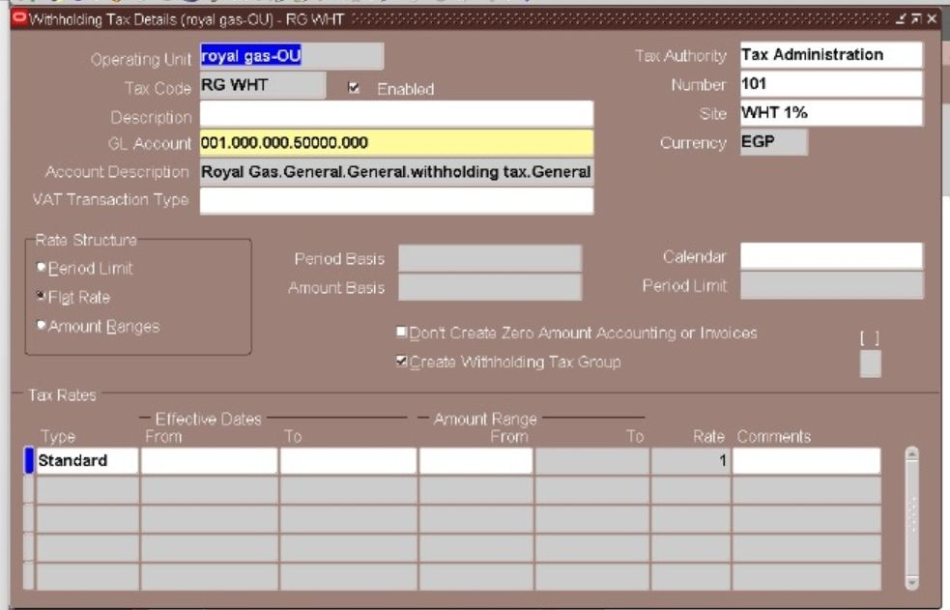
1. Create a Tax Authority as Supplier:
Supplier Name: Tax Administration
Supplier Type: Set as Tax Authority to indicate it represents a governmental or tax-collecting body.
2. Created a Withholding Tax Account:
A dedicated GL account was assigned to record withholding tax amounts accurately in the financial statements.

Slide 34
3. Performed the Withholding Tax Setup:
GL Account: Linked to the Withholding Tax expense account.
Tax Authority: Selected the previously created Tax Administration supplier.
Rate Structure: Configured as a Flat Rate, which applies a fixed percentage to the taxable amount.

Slide 35
7- Invoice Creation & Payment
To record supplier liabilities accurately by entering different types of invoices based on the nature of transactions Steps Performed:

Slide 36
Created Three Invoice Types:
Standard Invoice
Prepayment Invoice
Credit Memo

Slide 37
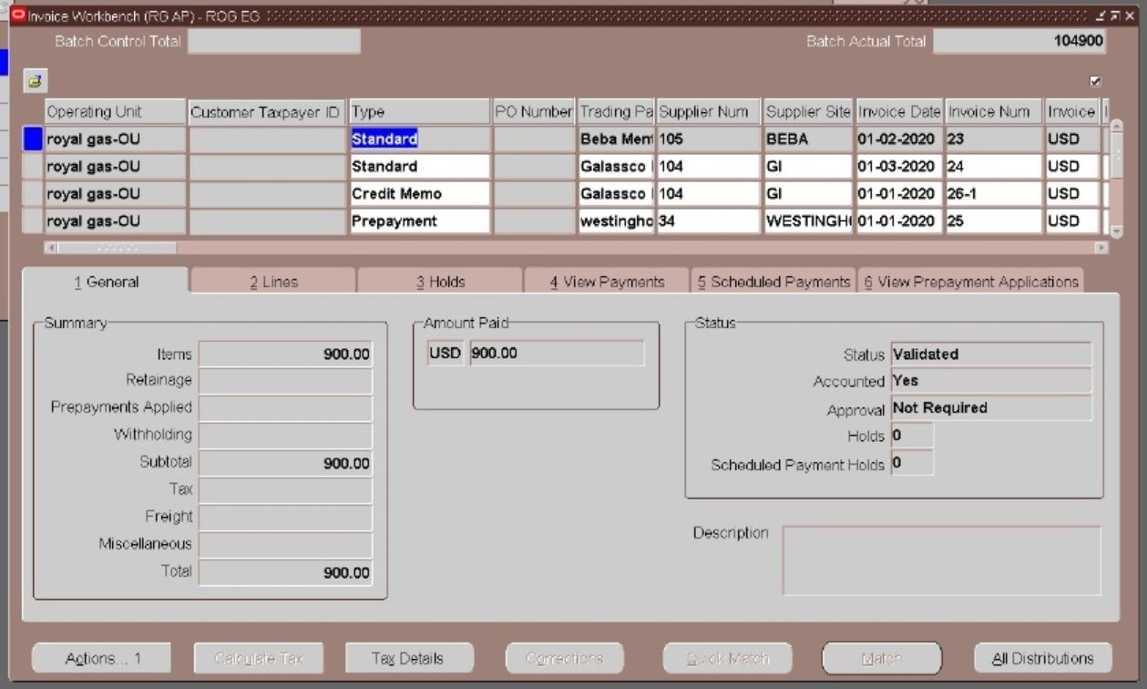
Standard Invoice
A. Standard Invoice
Details:
Supplier: Supplier [BEBA]
Amount: [e.g., 900 EGP]
Matched to Purchase Order
Accounted and validated successfully
2. Standard Invoice Payment
Invoice Type: Standard
Supplier: Supplier [BEBA]
Invoice Amount: 900 EGP
Payment Method: Check
Payment Status: Fully Paid
Bank Account Used: QNP

Slide 38
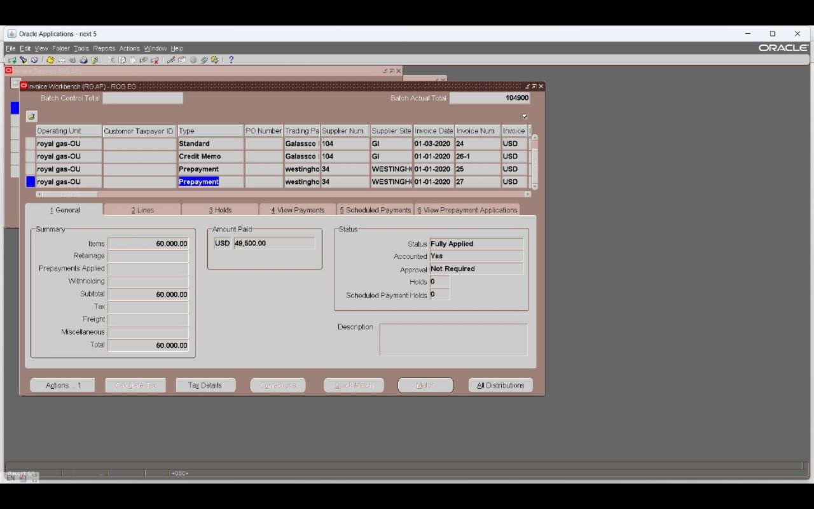
Prepayment Invoice
B. Prepayment Invoice
Details:
Supplier: Supplier [Westinghouse]
Amount: [e.g., 50,000 EGP]
Type: Prepayment
Marked as available for application to
future standard invoices
2. Prepayment Invoice Payment
Invoice Type: Prepayment
Supplier: Supplier [Westinghouse]
Invoice Amount: 50,000 EGP
Paid Amount: 49,500 EGP
Notes: Remaining 500 EGP represent tax expense.

Slide 39
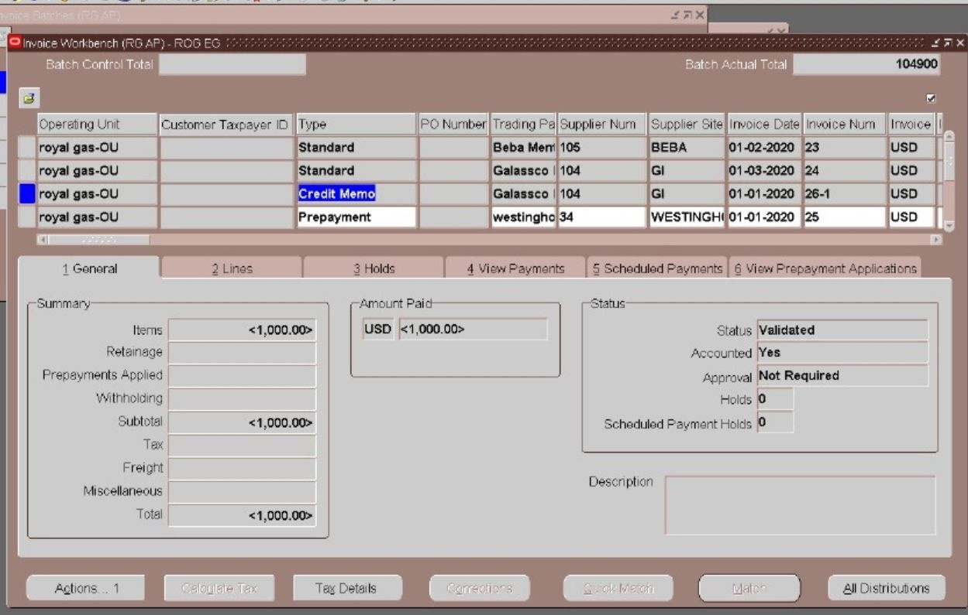
Credit Memo
C. Credit Memo
Details:
Supplier:Supplier [Galassco international]
Amount: [-1,000 EGP]
Applied to an existing standard
invoice Reduced liability accordingly
3. Credit Memo Application
Invoice Type: Credit Memo
Supplier:Supplier [Galassco international]
Credit Amount: <1,000> EGP
Effect: Reduced the net liability by 1,000 EGP
Status: Successfully applied and accounted
Validation Process: All invoices went through:
Invoice Validation Accounting Creation

Slide 40
8- Period Closing Report – Payables
To confirm successful closing of the Payables period after completing all accounting and payment activities.

Slide 41
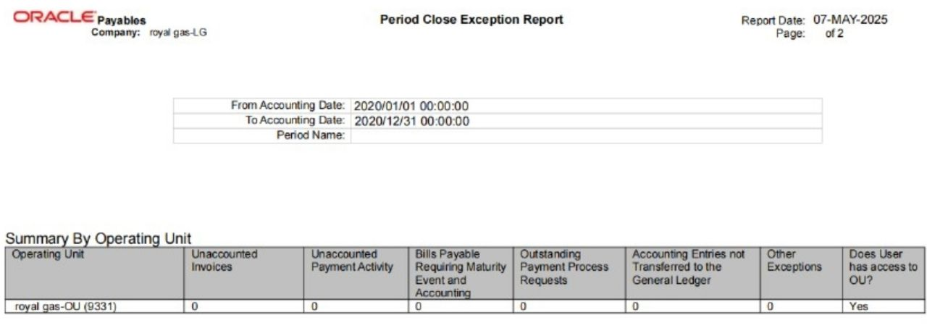
Report Overview:
Report Name: Payables Accounting Health Check
Period: From 01-Jan-2020 to 31-Jan-2020
Operating Unit: royal gas-OU
Key Metrics from the Report:
Metric Result
Unaccounted Invoices 0
Unaccounted Payment Activity 0
Bills Payable Requiring Maturity and Accounting 0
Outstanding Payment Process Requests 0
Accounting Entries Not Transferred to GL 0
Other Exceptions 0
Access Confirmation Yes

Slide 42
Conclusion
All invoices and payments have been validated, accounted, and transferred to the General Ledger
No outstanding exceptions, which confirms successful period closing
Oracle Payables period for January 2020 was closed cleanly without any corrective actions required

Slide 43

Our Team
Reem Saleh Baz
Muhammed Khalaf atef
Menna tullah Qurashi
Mohamed Abdel-Nasser Ebaid
Omar Abdelfattah Mohamed
Mohamed Mahmoud Mohamed
Supervision Eng
Haytham Ibrahim

